Slide 1

Movie Ratings on Streaming Services
Final Capstone
John Ford

Slide 2
Summary
Which streaming service has the highest average movie rating?
Netflix, Hulu, Prime Video and Disney+
Executives could be interested how their platform stacks up against competitors.

Slide 3
Data
16,744 movies across the four streaming services.
21 columns of data including, IMDb rating, director, which streaming service movie is on.
Data originally from Kaggle.

Slide 4
Methods
Descriptive statistics to see how each service compares.
Created new dataset for movies from each service, dropping null values.
Two Sample t-tests to compare sample of movies on each service to each other.
Histograms to visualize distribution.
 | Netflix Rating | Hulu Rating | Prime Video Rating | Disney Rating
count | 3442.000000 | 891.000000 | 11905.000000 | 563.000000
mean | 6.252963 | 6.145006 | 5.772365 | 6.441385
std | 1.139091 | 1.104691 | 1.394471 | 1.032950
min | 1.400000 | 2.200000 | 1.000000 | 1.600000
25% | 5.600000 | 5.400000 | 4.900000 | 5.800000
50% | 6.300000 | 6.200000 | 5.900000 | 6.500000
75% | 7.100000 | 7.000000 | 6.800000 | 7.200000
max | 9.300000 | 9.000000 | 9.300000 | 8.700000

Slide 5
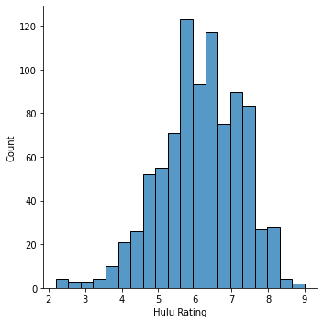
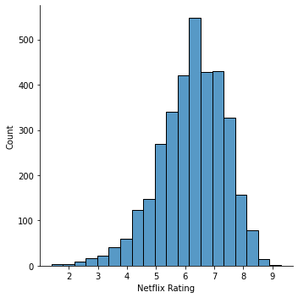
Netflix and Hulu
Comparing mean movie ratings between movies on Netflix and Hulu.
Using Ttest, reject the null hypothesis of no significant difference.
P value < .05 with 95% confidence difference in means is between -0.190 and -0.026.

Slide 6
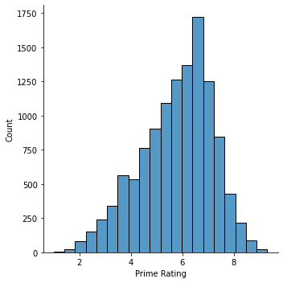
Netflix and Prime Video
Comparing mean movie ratings between movies on Netflix and Prime Video.
Using Ttest, reject the null hypothesis of no significant difference.
P value < .05 with 95% confidence difference in means is between -0.526 and -0.435.

Slide 7
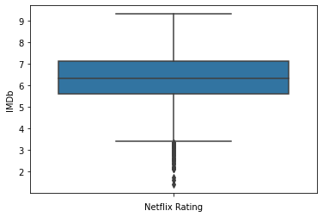
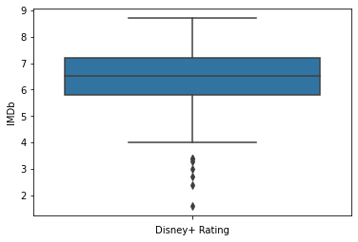
Netflix and Disney+
Comparing mean movie ratings between movies on Netflix and Disney+.
Using Ttest, reject the null hypothesis of no significant difference.
P value < .05 with 95% confidence difference in means is between 0.095 and 0.282.

Slide 8
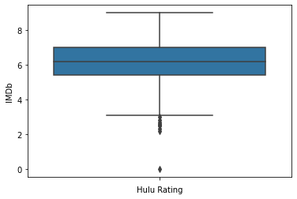
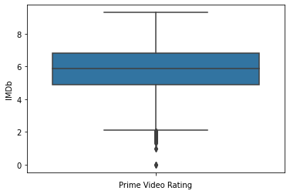
Hulu and Prime Video
Comparing mean movie ratings between movies on Hulu and Prime Video.
Using Ttest, reject the null hypothesis of no significant difference.
P value < .05 with 95% confidence difference in means is between -0.449 and -0.296.

Slide 9
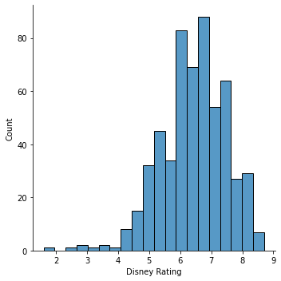
Hulu and Disney+
Comparing mean movie ratings between movies on Hulu and Disney+.
Using Ttest, reject the null hypothesis of no significant difference.
P value < .05 with 95% confidence difference in means is between 0.184 and 0.408.

Slide 10
Prime Video and Disney+
Comparing mean movie ratings between movies on Hulu and Disney+.
Using Ttest, reject the null hypothesis of no significant difference.
P value < .05 with 95% confidence difference in means is between 0.580 and 0.758.

Slide 11
Recommendations
Disney has the highest rated movies on service, followed by Netflix, Hulu and Prime Video.
Others may want to try to acquire higher rated movies to keep up.

Slide 12
Thank you!

